Slide 1


Slide 2
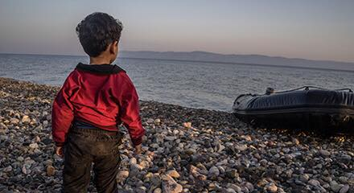

Slide 3


Slide 4
Demo

Slide 5
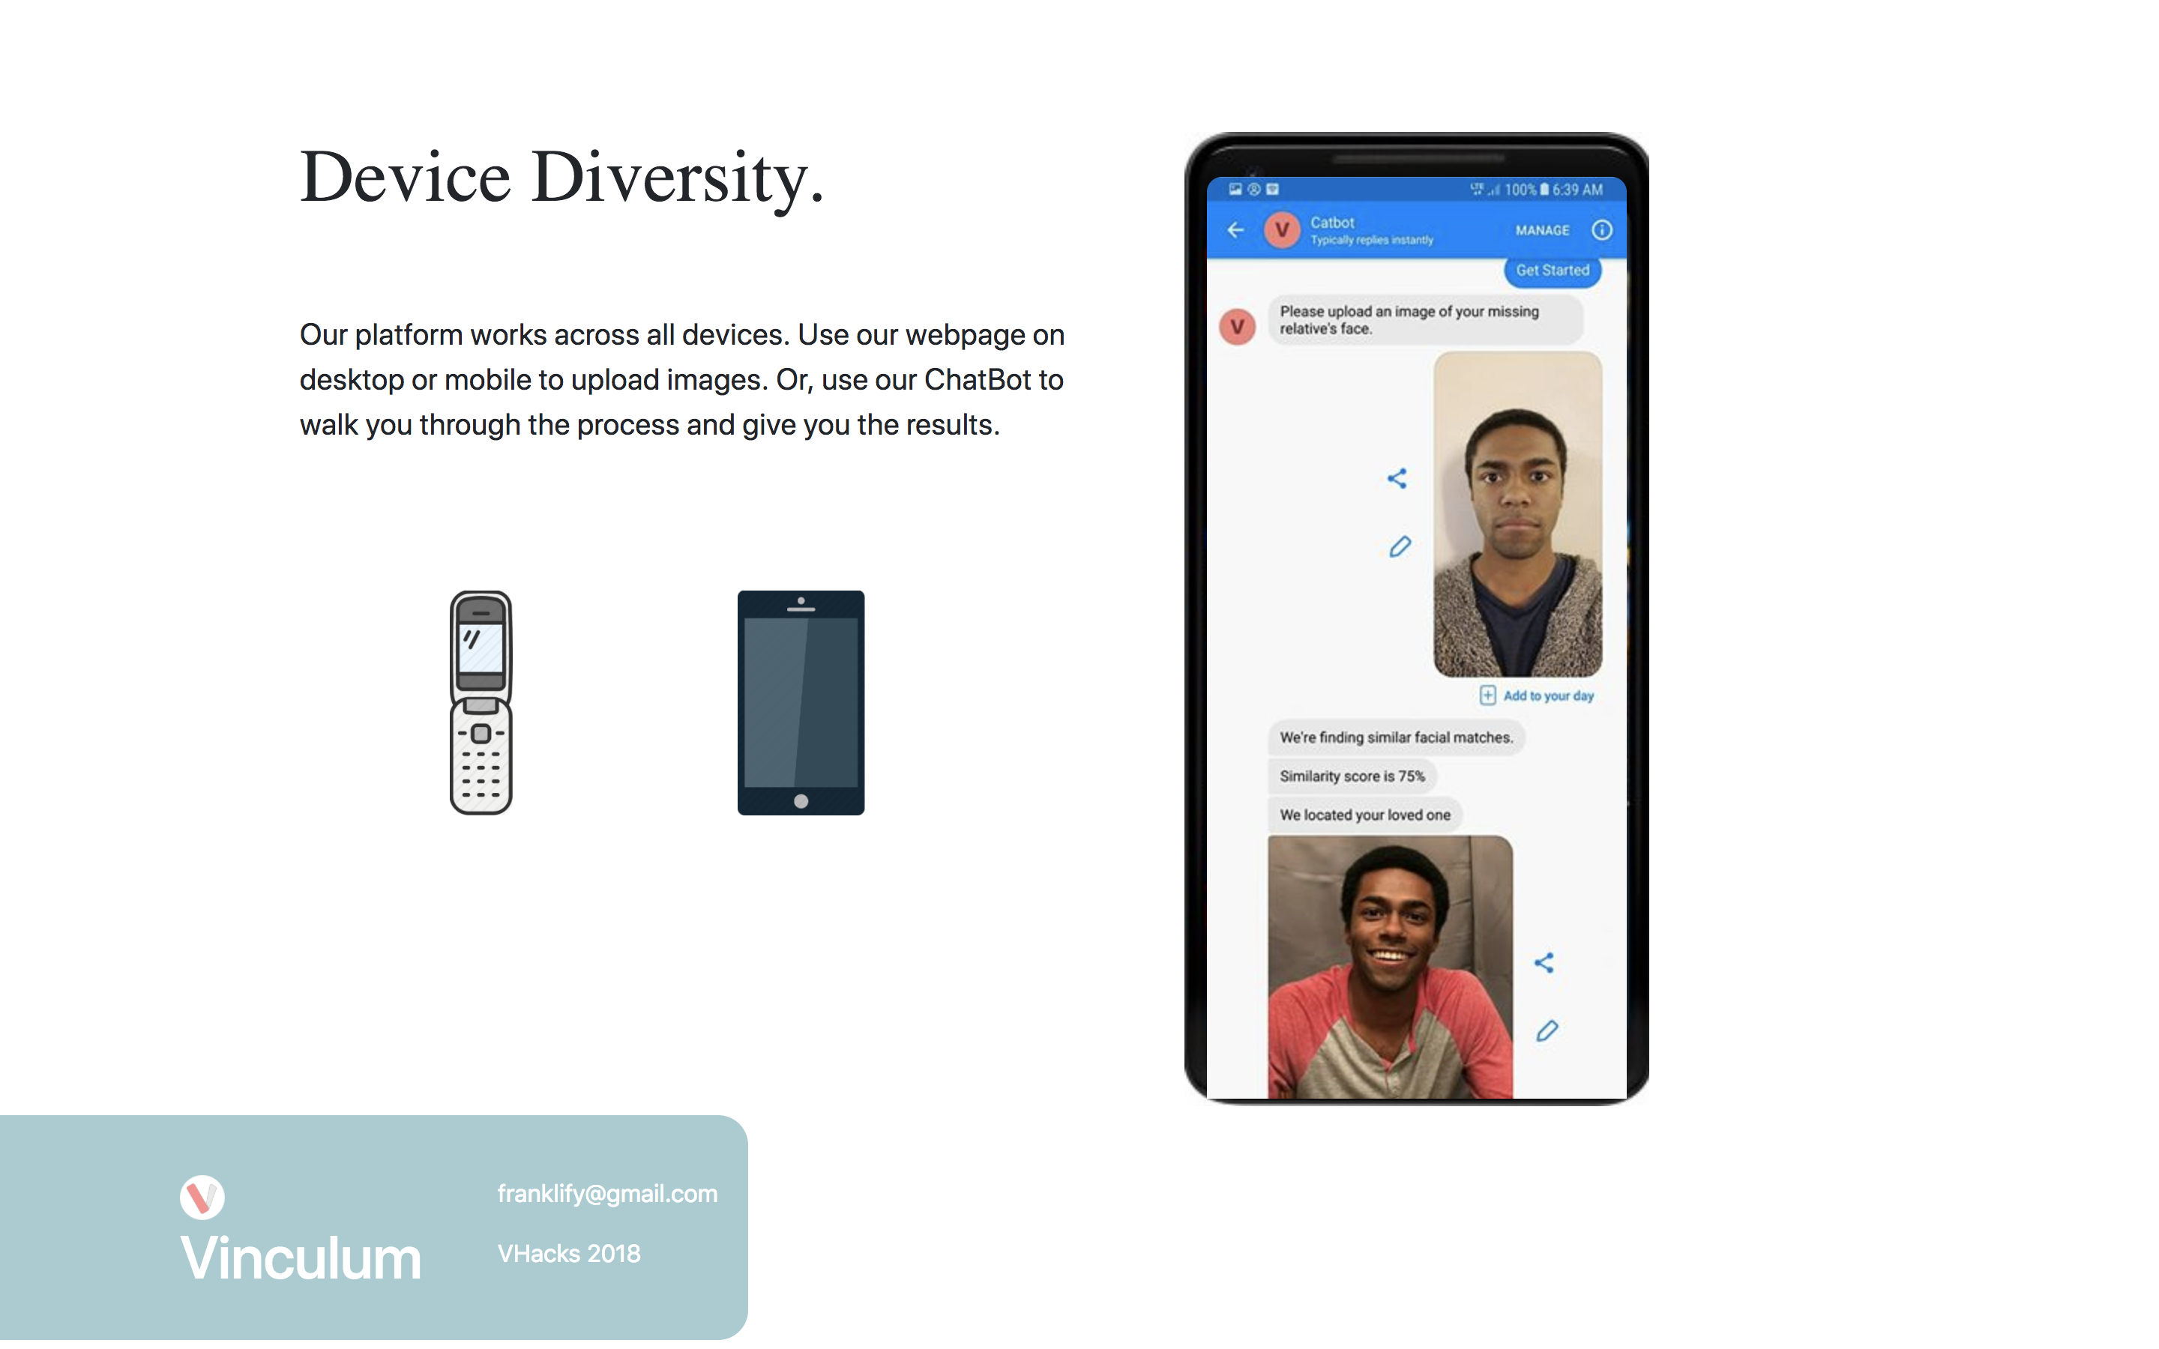

Slide 7

Privacy
Embassy Model
Own your own data

Slide 8
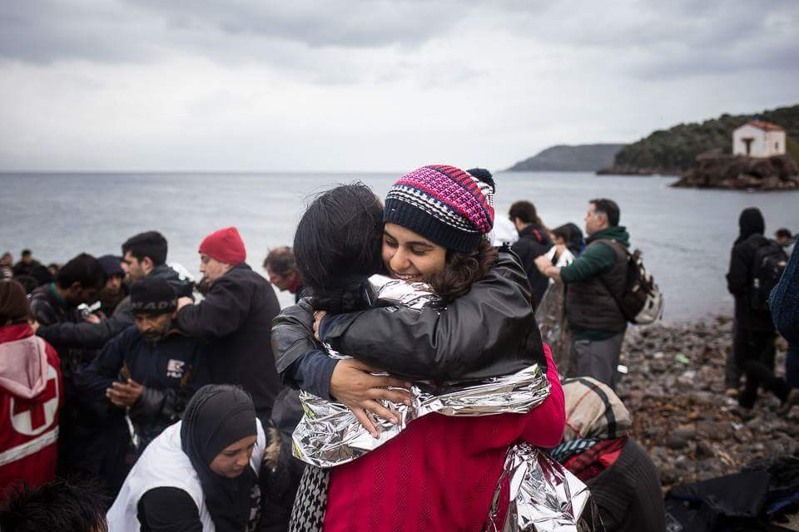
Road Map
1. A UK Refugee Camp
2. UNHCR, Red Cross, National Agencies
3. Certified User-generated content

Slide 9
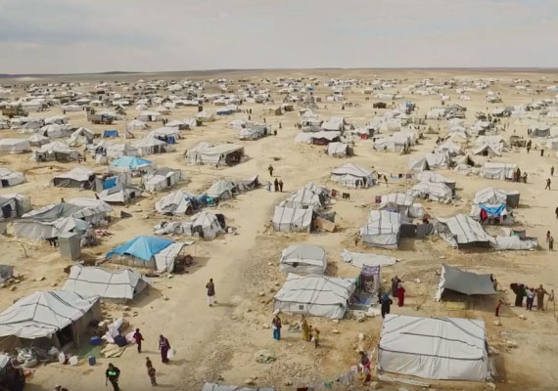
Summary
The upcoming refugees waves.
The moral case.
Rome

Slide 10

Thank You

